Slide 1
Assessments of PSO
Louis, Sweta, Albert

Slide 2
Graph #1

Slide 3
Probability of Success v.s. SNR
Definition of success:
The distance from the true highest Gaussian function point to the highest Gaussian function point from PSO algorithm is below 0.04
Formula:
Suppose the true highest Gaussian function to (0,0,0)
Suppose the highest Gaussian function point from PSO algorithm is (x,y,z)
The search is successful only if sqrt((x-0)^2+(y-0)^2+(z-0)^2)<0.04
How Data is Generated?
Do 1000 experiments at each SNR
Probability of success=#successful experiments/1000

Slide 4
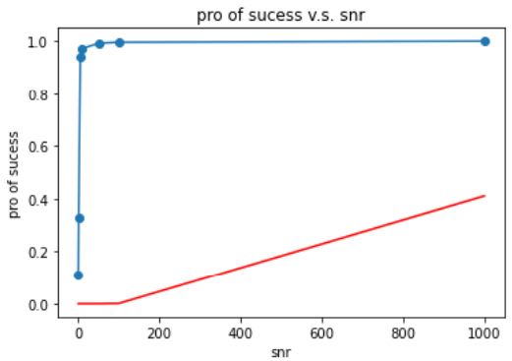
Probability of Success v.s. SNR (overall)
Red line is the data from Gradient search
Blue line is the data from PSO

Slide 5
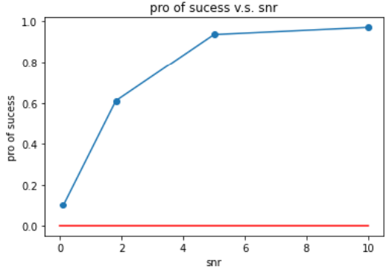
Probability of Success v.s. SNR
Red line is the data from Gradient search
Blue line is the data from PSO

Slide 6
Graph #2

Slide 7
Average movements of first success v.s. SNR
Definition of success
Definition of movements:
Every movements of piezo, same as the iteration in Gradient search
Movements=Iteration * #particles
How to calculate average movements?
Do 1000 experiments at each SNR
Average movements =#sum(movements)/1000

Slide 8
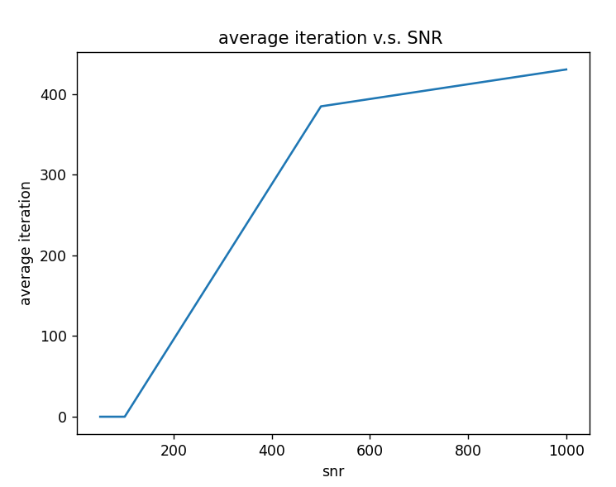
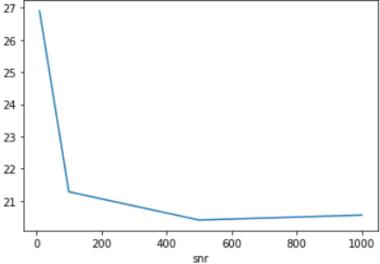
Average movements of first success v.s. SNR
PSO
Gradient search with learning rate 0.01

Slide 9
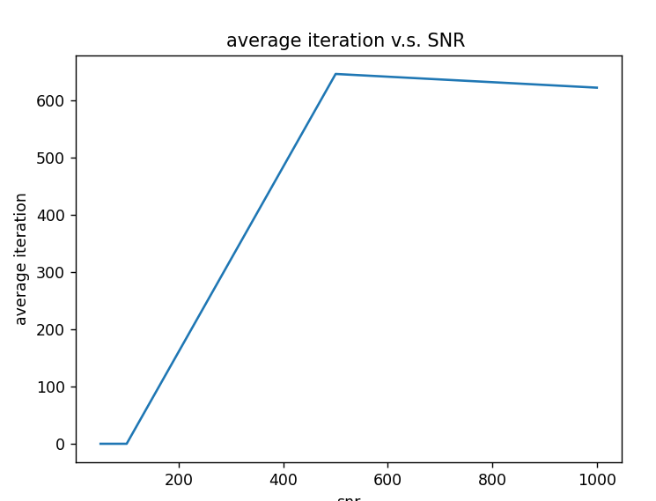
The problem of gradient search of increasing iteration with bigger SNR
I fix the starting point to (1,1,1), and the iteration time to 500
Why:
The problem of excluding the failed example. when SNR is low
there are only few succeed cases.
Generally, for low SNR , it can either find the aim during small iteration time or and failed when the iteration goes higher and is excluded
When I increase max iteration time to 1000, more success time for low SNR, it’s getting better

Slide 10
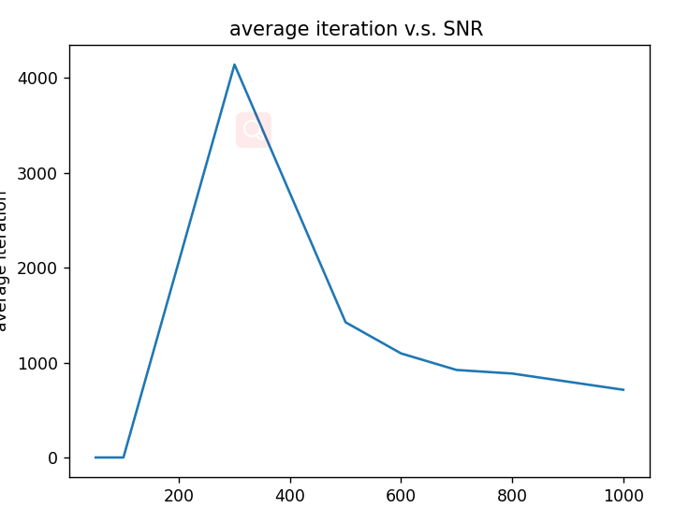
When max iteration is 10000
we just have to take more iterations
so that smaller SNR can find the point

Slide 11
Graph #3

Slide 12
Average # of movements till first success is achieved v.s. Average initial average distance
Definition of success
Definition of average movements
Definition of average initial distance:
The distance from the true highest Gaussian function (0,0,0) to the center of all the particles
How to draw the plot?
Generate particles whose initial center’s distance is within [ x_i, x_i+0.2 ], where x_i starts from 0, ends in 1, with step 0.2 for 200 times each interval
For each interval, calculate the average movements of first success
Assume the average movements of the whole interval is the average movements of the right-side point [x_i+0.2,average movements] and plot
Assume SNR==1000 to make camparison

Slide 13
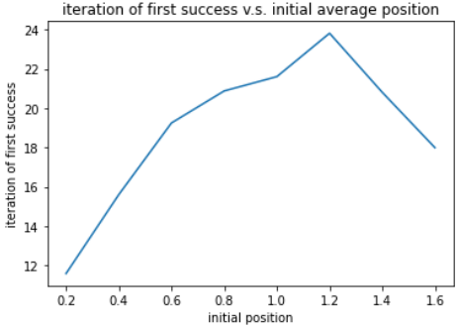
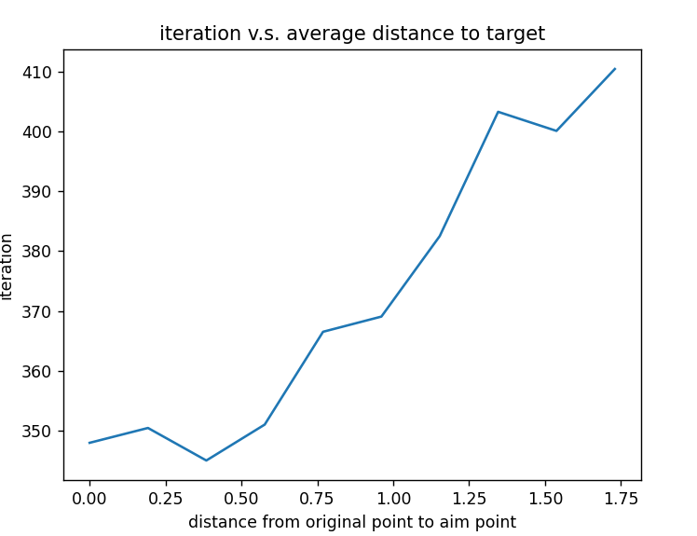
Average movements of first success v.s. Average initial average distance
Gradient search with learning rate 0.01
PSO

Slide 14
Graph #4
Probability of success v.s. initial average position when SNR==1000
For gradient search, each iterate 100 times

Slide 15
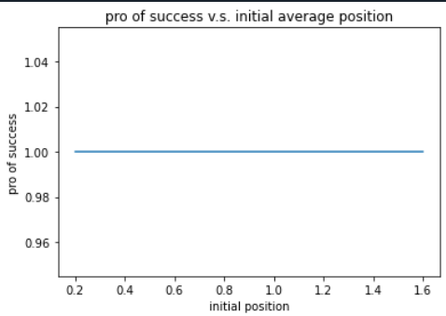
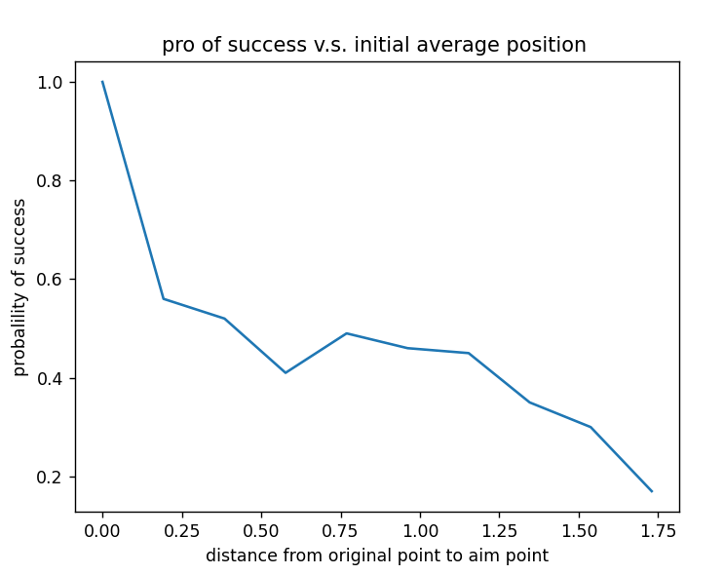
pro of success v.s. initial average position when SNR==1000
PSO
Gradient search with learning rate 0.01

